Slide 1
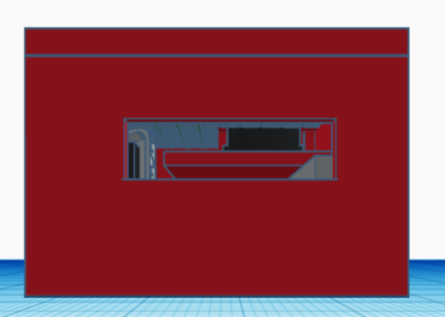
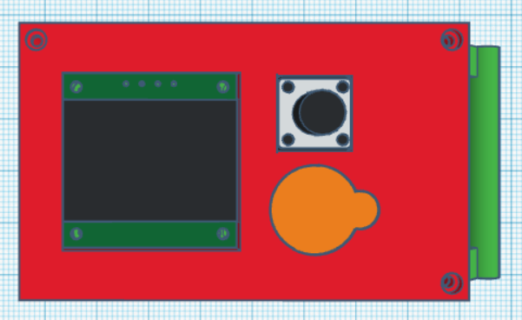
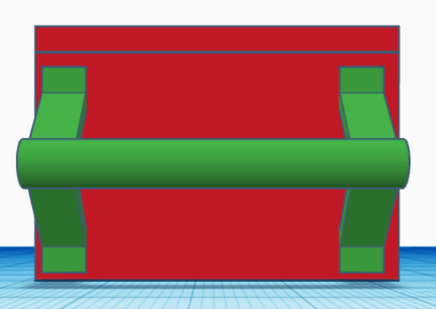
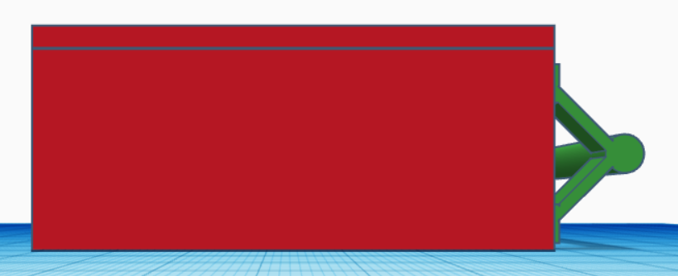
Specification
Above
Left
Right
27.3
12
3
24
27
7
43
40
13
5
30
5
70
Front
Buckle Weight
Materials
Compatible OS
Bluetooth
Components
Battery
200g
PLA
Android
Bluetooth 5.0
Slide Potentiometer
Linear Rail
Arduino LCD panel
CR1220(3V) *2
13
70
12.5

